Slide 1




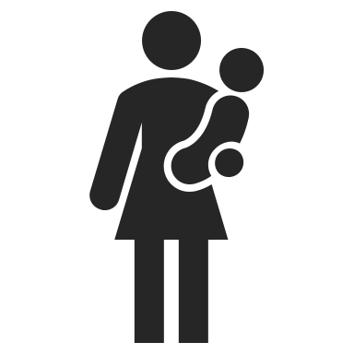









Network Causal Inference
Keletso Makofane, MPH
PhD Candidate in Social Epidemiology
Harvard University
www.keletsomakofane.com
@klts0
Notes:
a tweetorial about how I think about causal inference in the context of social networks

Slide 2
Causal Inference
Notes:
First – lets think about how causal inference is usually done.

Slide 3

L₁
A₁
Y₁
Keletso Makofane, March 2021
Notes:
You are interested in whether/how much an exposure A causes and outcome Y. You know that there is a confounder L that causes both A and Y.

Slide 4


L₁
A₁
Y₁
L₂
A₂
Y₂
L₃
A₃
Y₃
Keletso Makofane, March 2021
Notes:
You get a research grant and you sample as many people as you can. You measure L, A, and Y in each person. In effect, you end up estimating the joint statistical distribution of L,A,Y. You perform some statistical moves on this joint distribution in order to isolate the relationship between A and Y after accounting for L.

Slide 5


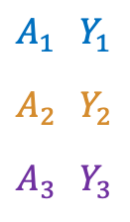
$$A_{1}$$ | $$Y_{1}$$
$$A_{2}$$ | $$Y_{2}$$
$$A_{3}$$ | $$Y_{3}$$
Treatment Effect
$$Y_{1}^{a_{1}=1}−Y_{1}^{a_{1}=0}$$
$$Y_{2}^{a_{2}=1}−Y_{2}^{a_{2}=0}$$
$$Y_{3}^{a_{3}=1}−Y_{3}^{a_{3}=0}$$
Keletso Makofane, March 2021
Notes:
Why do all this? Because you want to use the data to understand the results of the following thought experiment: Say I
a) give Person Blue the exposure A, wait a bit and record the outcome Y^a=1.
b) get in a time machine and return to the moment just before I gave person Blue A.
c) Withhold A from Person Blue, wait a bit and record the outcome Y^a=0.
Would there be a difference between Y^a=1 and Y^a=0? If yes, we say “A causes Y for person Blue”. If not, we say “A does not cause Y for person Blue”.
If A causes Y for any of the people Blue, Orange or Purple, then we say that “A causes Y”.

Slide 6

$$A_{1}$$ | $$Y_{1}$$
$$A_{2}$$ | $$Y_{2}$$
$$A_{3}$$ | $$Y_{3}$$
Treatment Effect
$$Y_{1}^{a_{1}=1}−Y_{1}^{a_{1}=0}$$
$$Y_{2}^{a_{2}=1}−Y_{2}^{a_{2}=0}$$
$$Y_{3}^{a_{3}=1}−Y_{3}^{a_{3}=0}$$
Average Treatment Effect
$$\frac{Y_{1}^{a_{1}=1}+Y_{2}^{a_{2}=1}+Y_{3}^{a_{3}=1}}{3} − \frac{Y_{1}^{a_{1}=0}+Y_{2}^{a_{2}=0}+Y_{3}^{a_{3}=0}}{3}$$
Keletso Makofane, March 2021
Notes:
Since we don’t have at time machine, we can’t answer whether A causes Y for each of these people individually, but we can say whether A causes Y on average. The Average Treatment Effect is the quantity we estimate in order to say something about the effect of A on Y within individuals.

Slide 7
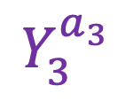
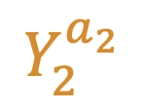
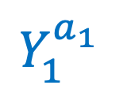
$$Y_{1}^{a_{1} }$$
$$Y_{2}^{a_{2}}$$
$$Y_{3}^{a_{3}}$$
Keletso Makofane, March 2021
Notes:
In summary – we run this study to learn something about the relationship between A and Y within individuals. i.e. We learn the answer to the question: ”On average, how does a particular person’s A affect that person’s Y?”

Slide 8
Network Causal Inference
Keletso Makofane, March 2021
Notes:
So far, there is no acknowledgement that Person’s Blue, Orange, and Purple could be related and that they could affect each other’s values of L, A, and Y. Lets think through what it looks like when we don’t make this assumption.

Slide 9
L₁
A₁
Y₁
L₂
A₂
Y₂
L₃
A₃
Y₃
Keletso Makofane, March 2021
Notes:
Say Blue and Orange are related, and Orange and Purple are related. Blue and Purple are not related except through Orange.

Slide 10
L₁
A₁
Y₁
L₂
A₂
Y₂
L₃
A₃
Y₃
Keletso Makofane, March 2021
Notes:
We might want to learn how one person’s A affect another person’s Y.

Slide 11
L₁
A₁
Y₁
L₂
A₂
Y₂
L₃
A₃
Y₃
Keletso Makofane, March 2021
Notes:
Also we want to know how one person’s L might affect another person’s A.

Slide 12
L₁
A₁
Y₁
L₂
A₂
Y₂
L₃
A₃
Y₃
Keletso Makofane, March 2021
Notes:
Finally we might want to know how one person’s L affect another’s Y. (note how this changes our understanding of confounding)

Slide 13
L₁
A₁
Y₁
L₂
A₂
Y₂
L₃
A₃
Y₃
Keletso Makofane, March 2021
Notes:
One last thing – we might want to assume that the L’s, A’s, and Y’s cause each other, but in a way where we can’t put a time ordering to these effects. Whereas up until this point we have had a complicated DAG, now we have a Chain Graph (a cousin of the DAG).

Slide 14
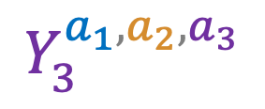
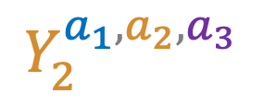
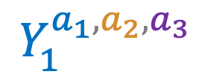
$$Y_{1}^{a_{1},a_{2},a_{3}}$$
$$Y_{2}^{a_{1},a_{2},a_{3}}$$
$$Y_{3}^{a_{1},a_{2},a_{3}}$$
Keletso Makofane, March 2021
Notes:
Now, when we allow for people to affect each other, we have a different set of counterfactual outcomes than before. Person Blue’s Y is not only caused by Person Blue’s A, but is also caused by Person Orange’s A and person Purple’s A.
So what is the thought experiment here? And what are we even estimating?

Slide 15

$$A_{1}$$ | $$Y_{1}$$
$$A_{2}$$ | $$Y_{2}$$
$$A_{3}$$ | $$Y_{3}$$
Treatment Effect
$$\left(\begin{matrix}Y_{1}^{a_{1}=1,a_{2}=1,a_{3}=1} \\ Y_{2}^{a_{1}=1,a_{2}=1,a_{3}=1} \\ Y_{3}^{a_{1}=1,a_{2}=1,a_{3}=1}\end{matrix}\right)−\left(\begin{matrix}Y_{1}^{a_{1}=0,a_{2}=0,a_{3}=0} \\ Y_{2}^{a_{1}=0,a_{2}=0,a_{3}=0} \\ Y_{3}^{a_{1}=0,a_{2}=0,a_{3}=0}\end{matrix}\right)$$
Keletso Makofane, March 2021
Notes:
Here is a thought experiment:
a) give Persons Blue, Orange, Purple the exposure A, wait a bit and record the outcomes.
b) get in a time machine and return to the moment just before we gave the people A.
c) Withhold A from the people, wait a bit and record the outcomes.
If there is a difference between the vectors of counterfactual outcomes then we say A causes Y.

Slide 16
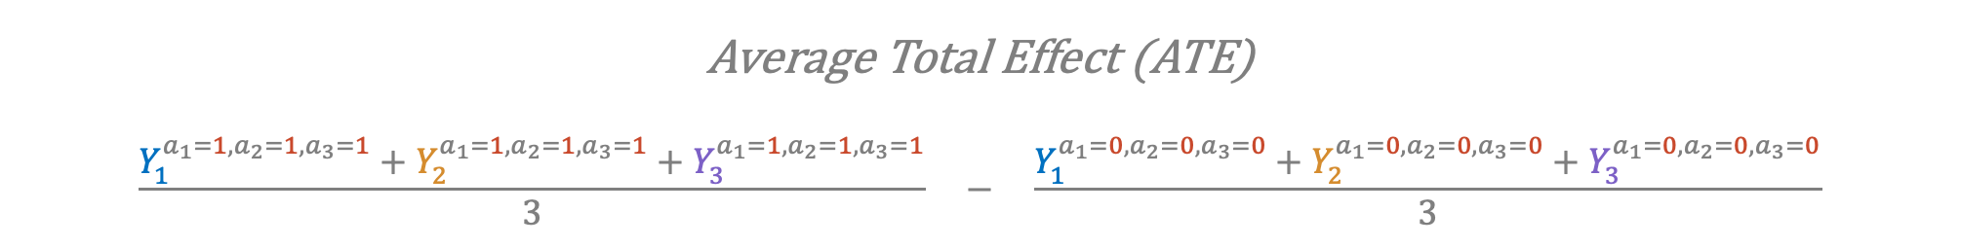
Average Total Effect (ATE)
$$\frac{Y_{1}^{a_{1}=1,a_{2}=1,a_{3}=1}+Y_{2}^{a_{1}=1,a_{2}=1,a_{3}=1}+Y_{3}^{a_{1}=1,a_{2}=1,a_{3}=1}}{3} − \frac{Y_{1}^{a_{1}=0,a_{2}=0,a_{3}=0}+Y_{2}^{a_{1}=0,a_{2}=0,a_{3}=0}+Y_{3}^{a_{1}=0,a_{2}=0,a_{3}=0}}{3}$$
L₁
A₁
Y₁
L₂
A₂
Y₂
L₃
A₃
Y₃
Keletso Makofane, March 2021
Notes:
We can summarize any difference between treatments by calculating the Average Total Effect

Slide 17
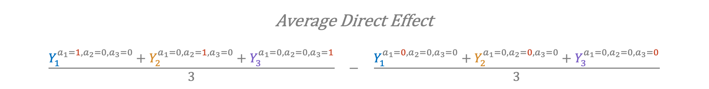
Average Direct Effect
$$\frac{Y_{1}^{a_{1}=1,a_{2}=0,a_{3}=0}+Y_{2}^{a_{1}=0,a_{2}=1,a_{3}=0}+Y_{3}^{a_{1}=0,a_{2}=0,a_{3}=1}}{3} − \frac{Y_{1}^{a_{1}=0,a_{2}=0,a_{3}=0}+Y_{2}^{a_{1}=0,a_{2}=0,a_{3}=0}+Y_{3}^{a_{1}=0,a_{2}=0,a_{3}=0}}{3}$$
L₁
A₁
Y₁
L₂
A₂
Y₂
L₃
A₃
Y₃
Keletso Makofane, March 2021
Notes:
We can create many, many thought experiments, though. Here is one where we manipulate each person’s treatment while ignoring other people’s treatments. This is called the Average Direct Effect: “On average, how does my outcome Y change as a function of my treatment A?”

Slide 18
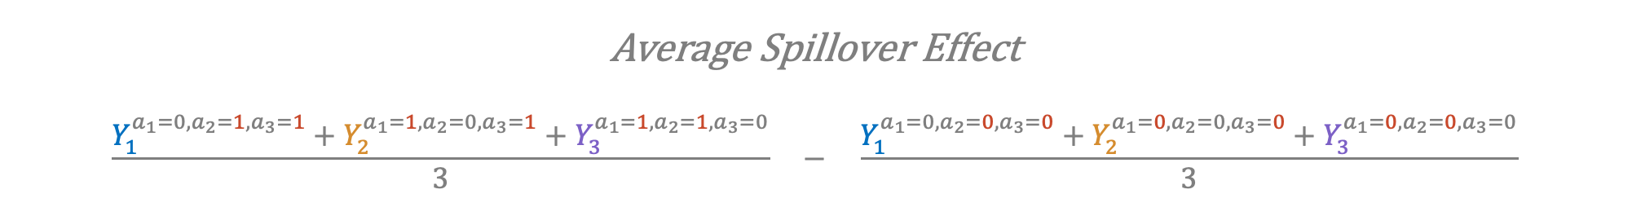
Average Spillover Effect
$$\frac{Y_{1}^{a_{1}=0,a_{2}=1,a_{3}=1}+Y_{2}^{a_{1}=1,a_{2}=0,a_{3}=1}+Y_{3}^{a_{1}=1,a_{2}=1,a_{3}=0}}{3} − \frac{Y_{1}^{a_{1}=0,a_{2}=0,a_{3}=0}+Y_{2}^{a_{1}=0,a_{2}=0,a_{3}=0}+Y_{3}^{a_{1}=0,a_{2}=0,a_{3}=0}}{3}$$
L₁
A₁
Y₁
L₂
A₂
Y₂
L₃
A₃
Y₃
Keletso Makofane, March 2021
Notes:
Here is another one: Here, we manipulate everyone else’s treatment and watch how a particular person’s outcome changes as a result of that: i.e. “How does my outcome Y change as a function of other peoples treatments A?”

Slide 19
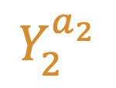
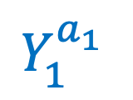
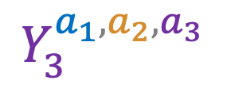
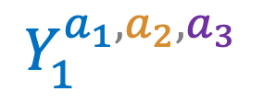
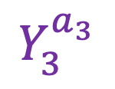
Causal Inference
Network Causal Inference
$$Y_{1}^{a_{1} }$$
$$Y_{1}^{a_{1},a_{2},a_{3}}$$
$$Y_{2}^{a_{2}}$$
Vs.
$$Y_{2}^{a_{1},a_{2},a_{3}}$$
$$Y_{3}^{a_{3}}$$
$$Y_{3}^{a_{1},a_{2},a_{3}}$$
Average Direct Effect
Average Spillover Effect
Average Total Effect
Average Treatment Effect
Keletso Makofane, March 2021
Notes:
In summary,
whereas the dominant way of doing causal inference assumes that a person’s outcome can only be explained by that person’s exposure, network causal inference assumes that a person’s outcome can be influenced by everyone else’s exposures.
With the former approach we can calculate average treatment effects. With the latter, we can calculate all kinds of effects. Here I have shown a decomposition into average direct and spillover effects.
What I have not shown here is how knowledge of the network can help u sot understand whose exposure affects whose outcome.
What I have also not talked about is estimation. We have positivity problems so we have to make some assumptions to get around those.

